Slide 1
TRADITIONAL METHODS VS AGILE
PRESENTED BY
D. PRETHIKA

Slide 2
OBJECTIVES
Understand different software development models (Waterfall, V-Model, Spiral, Agile Scrum) and their key features.
Compare the advantages and disadvantages of traditional and agile methodologies to choose the right model for different projects.

Slide 3
TRADITIONAL METHODS
Waterfall model
V – model
Spiral model

Slide 4
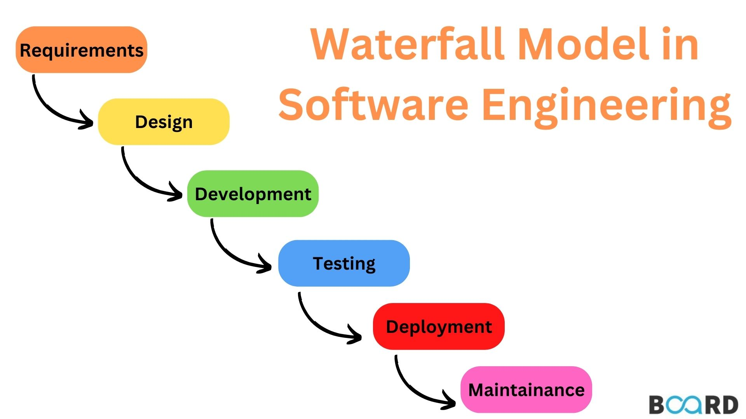
A sequential software development model where each phase must be completed before the next begins.
Advantages
Simple to understand and easy to manage due to its structured approach.
Disadvantages
Difficult to accommodate changes once the process is underway.
Late discovery of issues, since testing happens after development is complete.

Slide 5
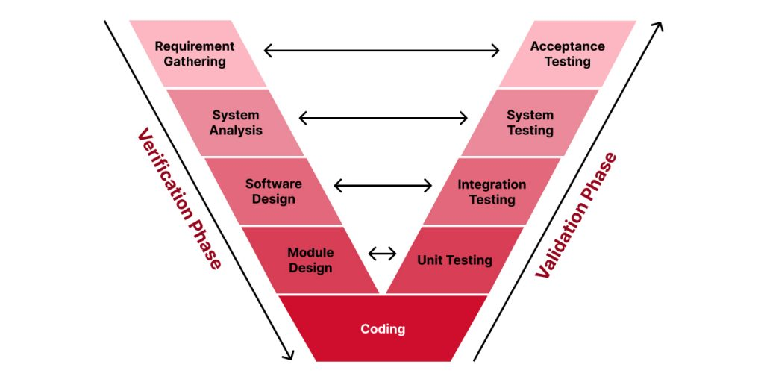
V MODEL
It is an extension of the Waterfall model where each development stage is directly associated with a testing phase.
It emphasizes verification (left side) and validation (right side) activities happening in parallel with development.
Advantages
Testing activities start early, improving defect detection. Clear and structured process with specific deliverables for each phase.
Disadvantages
Rigid model; difficult to adapt to changes once underway. Not suitable for projects with unclear or evolving requirements.

Slide 6
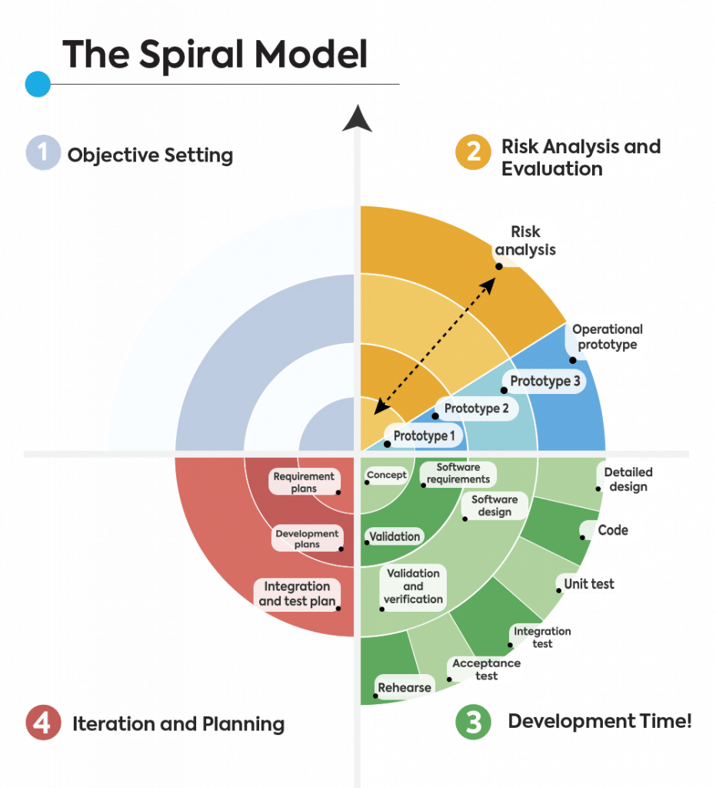
A software development model combining iterative development with systematic risk assessment.
The project passes through repeated cycles (spirals), focusing on planning, risk analysis, engineering, and evaluation.
Advantages
Strong focus on risk management and early identification of problems.
Disadvantages
Strong focus on risk management and early identification of problems. Requires expertise in risk assessment for effective implementation.

Slide 7
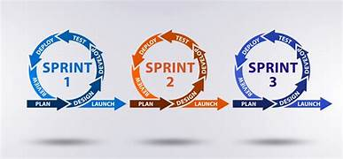
AGILE METHODOLOGY

Slide 8
DEFINITION
An Agile framework that breaks projects into small, manageable units called Sprints, typically lasting 2–4 weeks.
Focuses on continuous delivery of valuable product increments through collaboration, feedback, and adaptability.
Involves key roles like Product Owner, Scrum Master, and Development Team to manage tasks and ensure progress.

Slide 9
ADVANTAGES
Faster Delivery: Working software is delivered frequently, allowing quicker releases and feedback.
Flexibility: Scrum easily adapts to changes in requirements, even late in development.
Higher Product Quality: Continuous testing and integration improve overall product quality.
Better Team Collaboration: Daily stand-ups and sprint reviews foster strong communication and teamwork.

Slide 10
CONCLUSION
Traditional methods (like Waterfall) offer a structured, sequential approach, best for projects with well-defined and stable requirements
Agile methods (like Scrum) provide flexibility, faster feedback, and continuous improvement, making them ideal for dynamic and evolving projects.

Slide 11
THANK YOU

